Slide 1
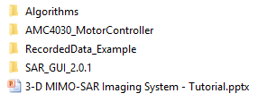
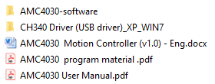
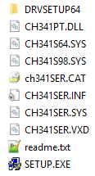
SOFTWARE INSTALLATION – AMC4030 DRIVERS
Open AMC4030-MotorController folder
Open CH340 Driver folder
Run Setup.exe to install drivers
For details, please refer to AMC4030 User Manual
1
2
3
4
1

Slide 2

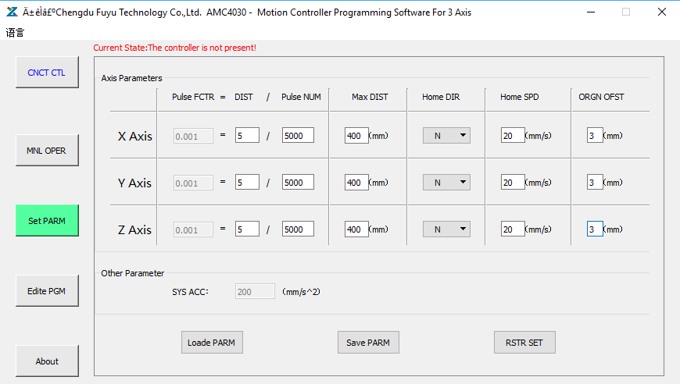
SCANNER CONFIGURATION
Open AMC4030-MotorController folder
Open AMC4030-software folder
Run AMC4030.exe
Connect to the scanner. Before, physical connection has to be established via a USB cable!
Configure the scanner parameters. Please be careful about the notes given below!
Save the parameters
2
1
3
4
Notes for the scanner hardware configuration:
DIST has to be 5 mm for the current scanner
Pulse NUM has to be compatible with HW settings (Please refer to the next page)
Max DIST has to be 400 mm for the scanner (check the HW!)
Home SPD is suggested to be set as 20 mm/s
For details, please refer to AMC4030 User Manual
5
6
2

Slide 3
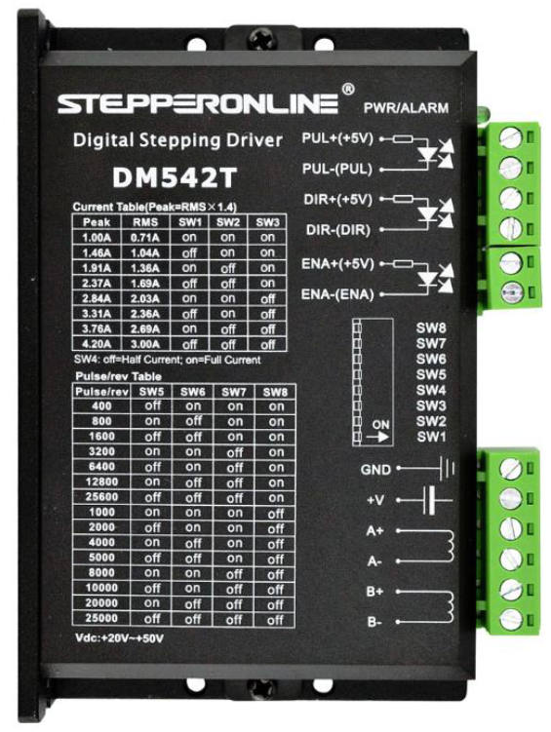
SCANNER CONFIGURATION - hardware
At each step driver, there are jumper settings to configure the number of pulses per revolution (Refer to 1)
These settings have to be consistent with the AMC4030 controller parameters (Refer to 2)
2
1
3

